Slide 1


Roberto Baladrón Pardo
10/11/2024

Slide 2

Outline
Executive Summary
Introduction
Methodology
Results
Conclusion
Appendix

Slide 3
Executive Summary
Summary of methodologies
Data Collection via API
Data Collection throug Web Scraping
Data Wrangling
Exploratory Data Analysis (EDA) with SQL
Exploratory Data Analysis with Data Visualization
Interactive Visual Analytics with Folium
Machine Learning for Predictive Modeling
Summary of all results
Exploratory Data Analysis findings
Interactive analytics (Screendshots)
Predictive Analytics Outcomes

Slide 4
Introduction
Project Background and Context
SpaceX advertises Falcon 9 rocket launches on its website at a cost of $62 million, while other providers charge upwards of $165 million per launch. Much of SpaceX's cost advantage comes from its ability to reuse the rocket's first stage. By predicting whether the first stage will successfully land, we can estimate the actual cost of each launch. This information is valuable for potential competitors considering bidding against SpaceX for launch contracts. The objective of this project is to develop a machine learning pipeline to predict the likelihood of a successful first-stage landing.
Key Questions to Address
What factors influence the likelihood of a successful rocket landing?
How do different features interact to impact landing success rates?
What operating conditions are necessary to ensure a reliable landing program?

Slide 5

Section 1

Slide 6
Methodology
Executive Summary
Data collection methodology:
Data was collected using SpaceX API and through web scraping from Wikipedia site.
Perform data wrangling
To clean and prepare the dataset, then conduct Exploratory Data Analysis (EDA) to identify patterns and insights. This process will help determine the appropriate label for training supervised models.
Perform exploratory data analysis (EDA) using visualization and SQL
Perform interactive visual analytics using Folium and Plotly Dash
Perform predictive analysis using classification models
Steps to build, tune, and evaluate classification models

Slide 7
Data Collection
The data was gathered using multiple methods. First, we used GET requests to the SpaceX API, then decoded the response content in JSON format with the .json() function, and converted it into a Pandas DataFrame with .json_normalize().
Afterwards, we cleaned the data by checking for and filling in any missing values as needed. Additionally, we performed web scraping on Wikipedia using BeautifulSoup to obtain Falcon 9 launch records. The goal was to extract launch records from an HTML table, parse it, and convert it into a Pandas DataFrame for further analysis.

Slide 8
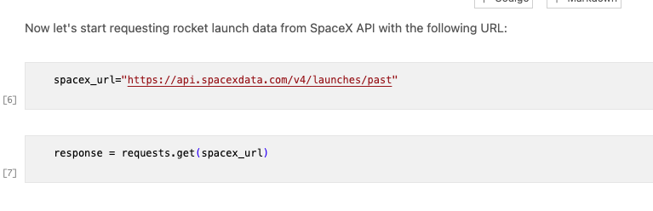
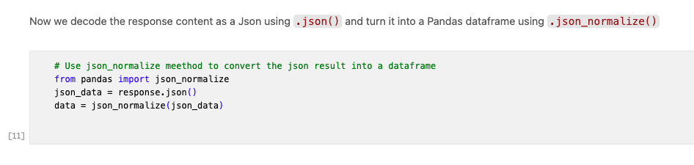
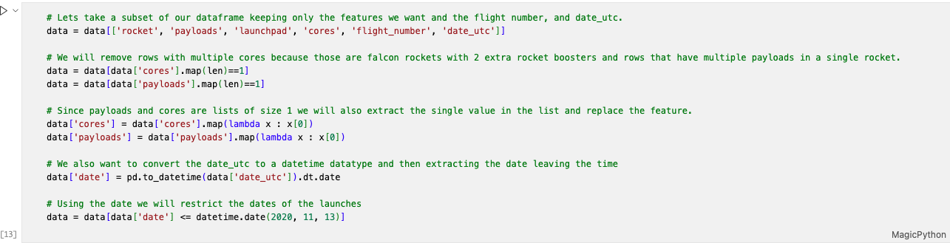
Data Collection – SpaceX API
We used a GET request to the SpaceX API to collect data, clean the retrieved data, and perform basic data wrangling and formatting
For more details, refer to the notebook at: https://github.com/rbaladron/IBM-Data_Science-Capstone-Project/blob/fdf1fe6efa7643c379978d743b522b89e5754190/IBM-Data_Science_Capstone_Project/01_SpaceX_data_collection_api.ipynb

Slide 9
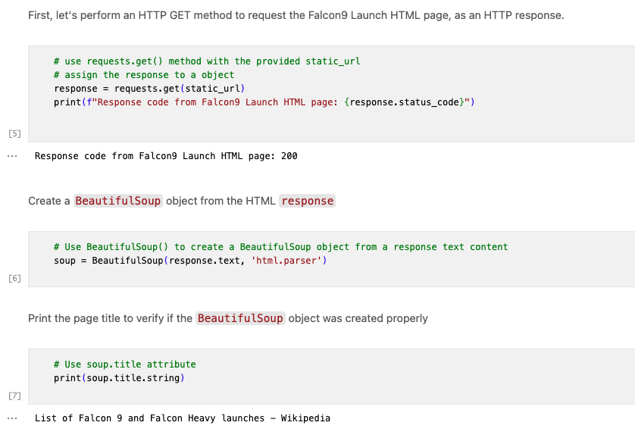
Data Collection – Scraping
We will perform web scraping to collect historical Falcon 9 launch records from the Wikipedia page titled List of Falcon 9 and Falcon Heavy launches.
URL: https://en.wikipedia.org/wiki/List_of_Falcon_9_and_Falcon_Heavy_launches
We used web scraping with BeautifulSoup to extract Falcon 9 launch records.
For more details, refer to the notebook at:
https://github.com/rbaladron/IBM-Data_Science-Capstone-Project/blob/fdf1fe6efa7643c379978d743b522b89e5754190/IBM-Data_Science_Capstone_Project/02_SpaceX_data_collection_web_scraping.ipynb
Place your flowchart of web scraping here

Slide 10
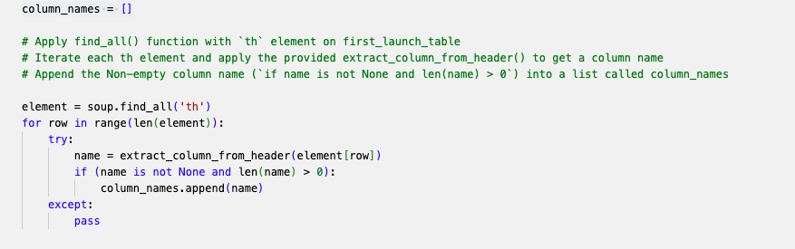
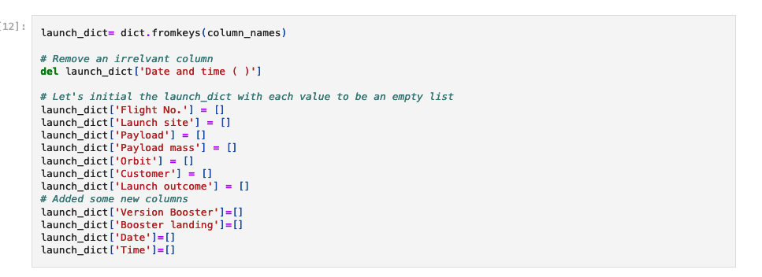
Data Collection - Scraping
The column names was extracted from the HTML header.
A dictionary was created using the column names as keys, and the corresponding launch records were populated from the table rows.
For more details, refer to the notebook at:
https://github.com/rbaladron/IBM-Data_Science-Capstone-Project/blob/fdf1fe6efa7643c379978d743b522b89e5754190/IBM-Data_Science_Capstone_Project/02_SpaceX_data_collection_web_scraping.ipynb
Place your flowchart of web scraping here

Slide 11
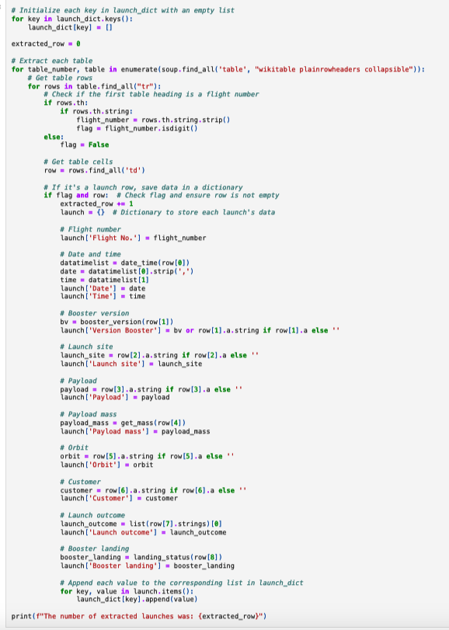
Data Collection - Scraping
All tables were parsed from the HTML and converted into Pandas DataFrame for analysis.
For more details, refer to the notebook at:
https://github.com/rbaladron/IBM-Data_Science-Capstone-Project/blob/fdf1fe6efa7643c379978d743b522b89e5754190/IBM-Data_Science_Capstone_Project/02_SpaceX_data_collection_web_scraping.ipynb
Place your flowchart of web scraping here

Slide 12
Data Wrangling
In this analysis, we will conduct Exploratory Data Analysis (EDA) to identify patterns in the data and determine the appropriate labels for training supervised models.
The dataset contains several instances where the booster did not land successfully. In some cases, a landing attempt failed due to an accident. For example, True Ocean indicates a successful landing in a specific ocean region, while False Ocean indicates an unsuccessful landing in the ocean. Similarly, True RTLS denotes a successful landing on a ground pad, while False RTLS indicates an unsuccessful landing on a ground pad. True ASDS represents a successful landing on a drone ship, and False ASDS indicates an unsuccessful landing on a drone ship.
The landing outcomes will be converted into training labels, where 1 indicates a successful landing and 0 indicates an unsuccessful landing.

Slide 13
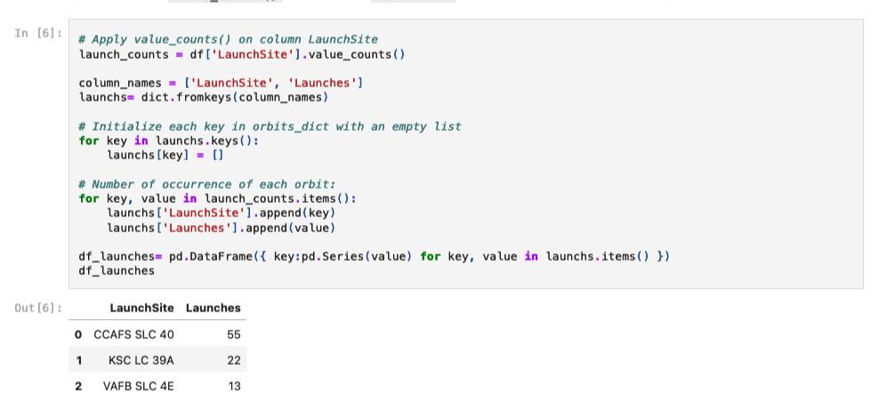
Data Wrangling
The dataset includes several SpaceX launch facilities, such as:
Cape Canaveral Space Launch Complex 40 (CCAFS LC-40)
Vandenberg Air Force Base Space Launch Complex 4E (SLC-4E)
Kennedy Space Center Launch Complex 39A (KSC LC-39A)
Each launch location is recorded in the LaunchSite column.
For more details, refer to the notebook at:
https://github.com/rbaladron/IBM-Data_Science-Capstone-Project/blob/fdf1fe6efa7643c379978d743b522b89e5754190/IBM-Data_Science_Capstone_Project/03_SpaceX_Data%20_wrangling.ipynb
Place your flowchart of web scraping here

Slide 14
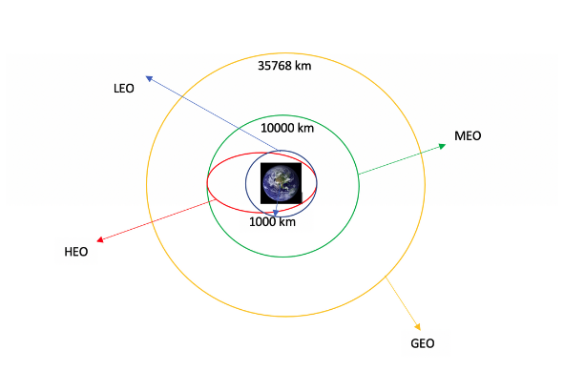
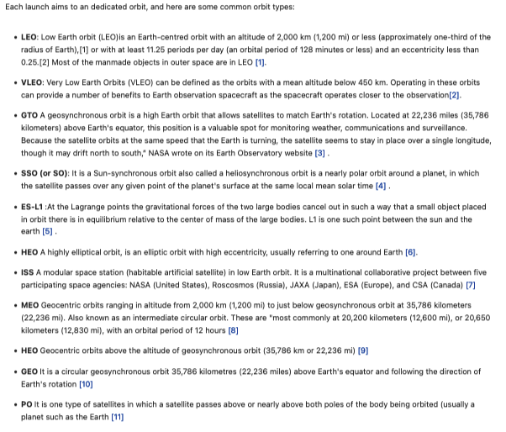
Data Wrangling
Place your flowchart of web scraping here

Slide 15
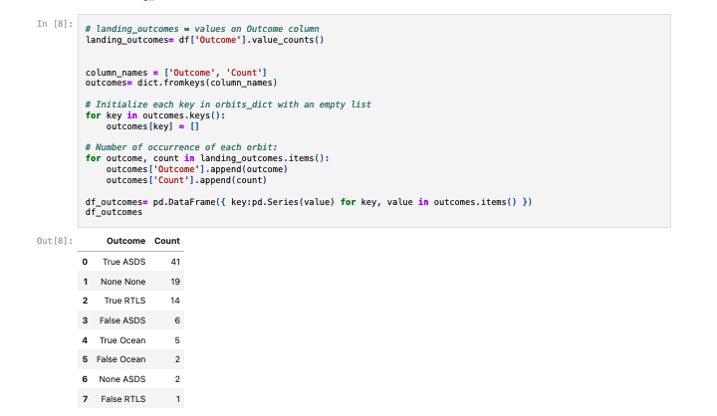
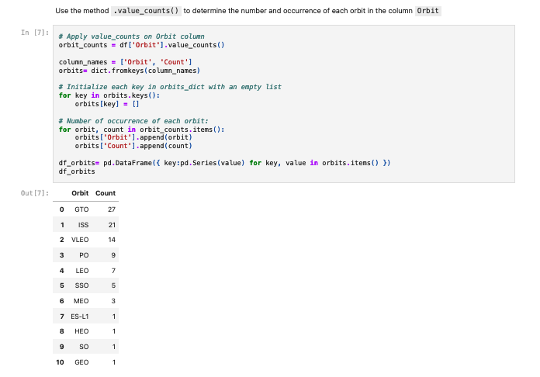
Data Wrangling
Calculate the Number and Occurrence of Each Orbit and Mission Outcome
In this analysis, we will calculate:
The number and occurrence of each orbit type.
The number and occurrence of mission outcomes for each orbit type.
By analyzing the data, we can explore how different orbits correlate with mission success or failure.

Slide 16
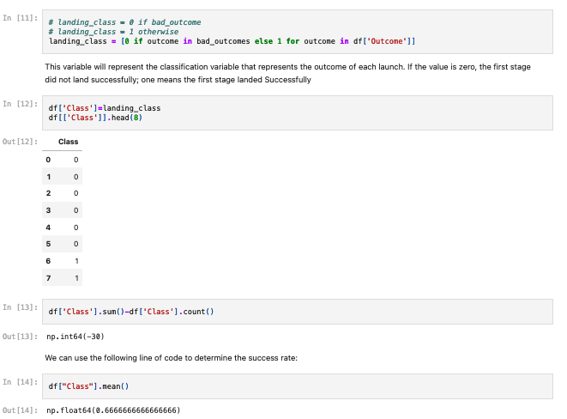
Data Wrangling
Create a Landing Outcome Label from the Outcome Column
Using the Outcome column, we will create a new list where:
The element is 0 if the corresponding row in Outcome is in the set of bad_outcome (indicating a failed landing).
The element is 1 if the landing was successful.
This new list will be assigned to the variable landing_class.
For more details, refer to the notebook at:
https://github.com/rbaladron/IBM-Data_Science-Capstone-Project/blob/fdf1fe6efa7643c379978d743b522b89e5754190/IBM-Data_Science_Capstone_Project/03_SpaceX_Data%20_wrangling.ipynb

Slide 17
EDA with Data Visualization
In this analysis, we will visualize key relationships in the data:
Flight Number vs. Launch Site: Visualize the distribution of flights across different launch sites.
Payload vs. Launch Site: Explore the relationship between payload and launch site.
Success Rate of Each Orbit Type: Visualize the success rate for each orbit type.
Flight Number vs. Orbit Type: Analyze how flight numbers are distributed across different orbit types.
Pay Load vs. Orbit Type: Analize how pay load are distributed acrross different orbit types.
Launch Success Yearly Trend: Visualize the trend of launch success over the years.
These visualizations will help identify patterns and insights in the data.
For more details, refer to the notebook at:
https://github.com/rbaladron/IBM-Data_Science-Capstone-Project/blob/fdf1fe6efa7643c379978d743b522b89e5754190/IBM-Data_Science_Capstone_Project/05_SpaceX_eda_dataviz.ipynb

Slide 18
EDA with SQL
The SpaceX dataset was then loaded into a SQLite database directly from the Jupyter notebook, allowing for Exploratory Data Analysis (EDA) using SQL.
A function was first created to execute various queries in the database, making it easier to explore different aspects of the data.
Key queries included:
Finding the names of unique launch sites in the space missions.
Calculating the total payload mass carried by boosters launched by NASA (CRS).
Determining the average payload mass carried by the F9 v1.1 booster version.
Counting the total number of successful and failed mission outcomes.
Identifying failed landing outcomes on drone ships, along with their booster version and corresponding launch site names.
These SQL queries provided valuable insights into the dataset.
For more details, refer to the notebook at:
https://github.com/rbaladron/IBM-Data_Science-Capstone-Project/blob/fdf1fe6efa7643c379978d743b522b89e5754190/IBM-Data_Science_Capstone_Project/04_SpaceX_eda_sql.ipynb

Slide 19
Build an Interactive Map with Folium
All launch sites were marked, and map features such as markers, circles, and lines were added to indicate the success or failure of launches at each site.
Launch outcomes were assigned binary classes: 0 for failure and 1 for success.
Using color-coded marker clusters, launch sites with relatively high success rates were identified.
Distances between launch sites and their surrounding areas were calculated to answer key questions:
Are launch sites near railways, highways, and coastlines?
Do launch sites maintain a certain distance from cities?
These visualizations and analyses provided insights into the spatial relationships of the launch sites.
For more details, refer to the notebook at:
https://github.com/rbaladron/IBM-Data_Science-Capstone-Project/blob/fdf1fe6efa7643c379978d743b522b89e5754190/IBM-Data_Science_Capstone_Project/06_SpaceX_interactive_visual_analitics_with_folium.ipynb

Slide 20
Build a Dashboard with Plotly Dash
An interactive dashboard was created using Plotly Dash.Pie charts were plotted to show the total number of launches by each site.A scatter plot was created to visualize the relationship between launch outcomes and payload mass (in kg) for different booster versions.
For more details, refer to the notebook at:
https://github.com/rbaladron/IBM-Data_Science-Capstone-Project/blob/fdf1fe6efa7643c379978d743b522b89e5754190/IBM-Data_Science_Capstone_Project/07_SpaceS_dash_app.py

Slide 21
Predictive Analysis (Classification)
The data was loaded using NumPy and pandas, followed by data transformation and splitting into training and testing sets.
Different machine learning models were built and hyperparameters were tuned using GridSearchCV.
Accuracy was used as the evaluation metric, and the model was improved through feature engineering and algorithm tuning.
The best-performing classification model was identified.
For more details, refer to the notebook at:
https://github.com/rbaladron/IBM-Data_Science-Capstone-Project/blob/fdf1fe6efa7643c379978d743b522b89e5754190/IBM-Data_Science_Capstone_Project/07_SpaceS_dash_app.py

Slide 22
Results
Exploratory data analysis results
Interactive analytics demo in screenshots
Predictive analysis results

Slide 23

Section 2

Slide 24
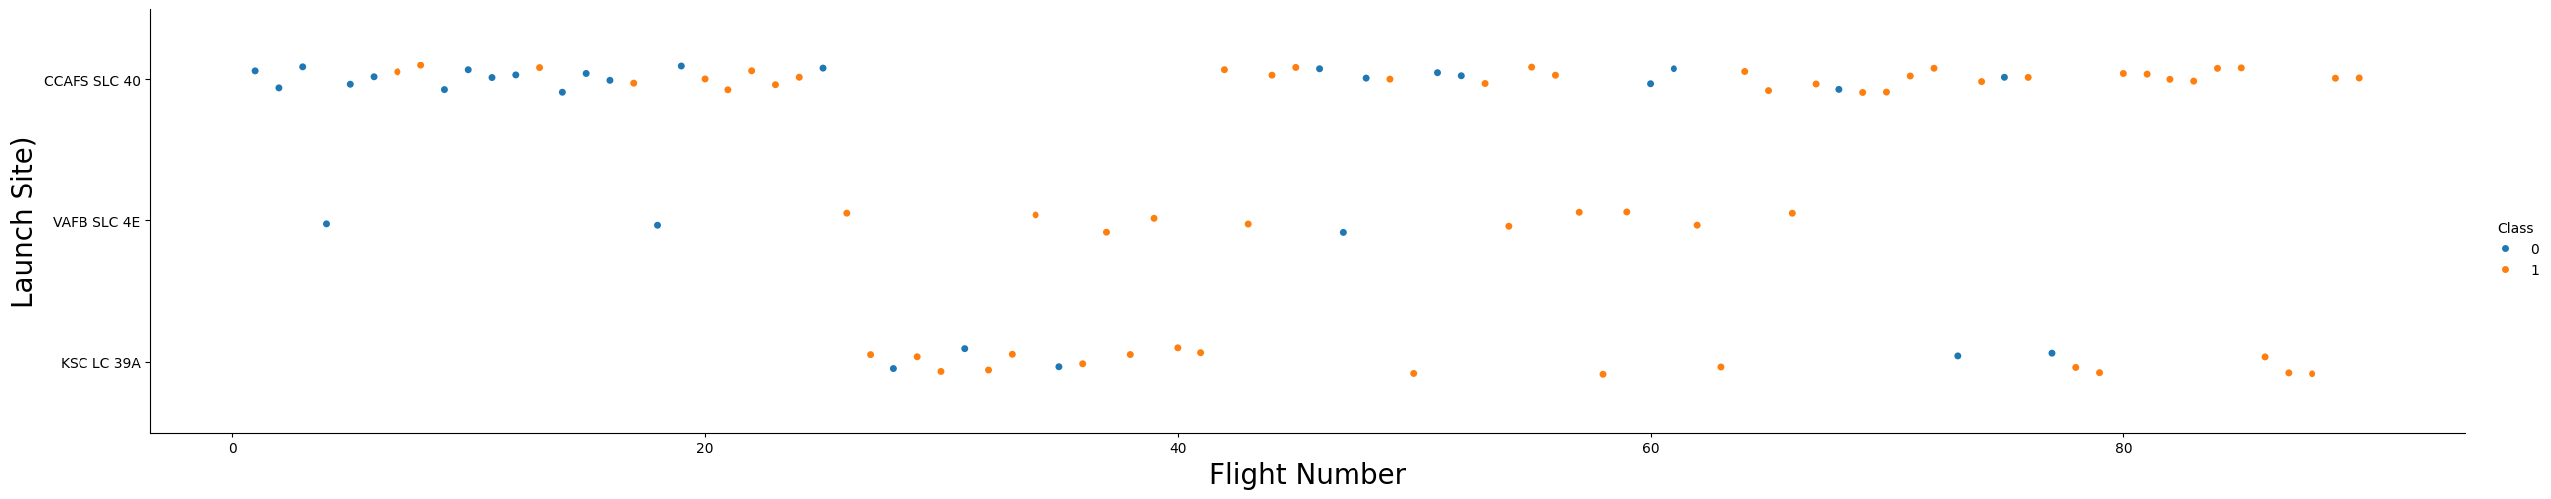
Flight Number vs. Launch Site
Observation from the Plot
The plot revealed that the higher the number of flights at a launch site, the greater the success rate at that site.

Slide 25
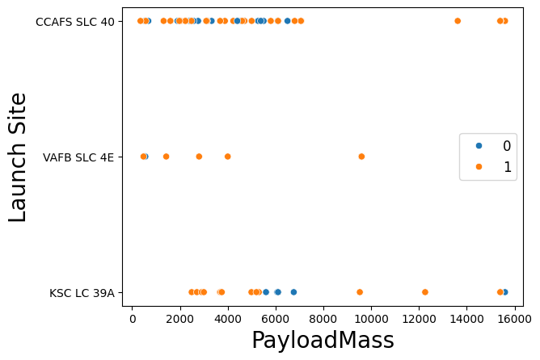
Payload vs. Launch Site
Key Findings:
Three primary launch sites: CCAFS SLC 40, VAFB SLC 4E, and KSC LC 39A.
Payload mass varies significantly across sites and launches.
CCAFS SLC 40 handles a wide range of payload masses, including heavier payloads.
VAFB SLC 4E accommodates a moderate range of payload masses.
KSC LC 39A primarily launches lighter payloads.
Possible Interpretations:
Payload mass is influenced by mission type, launch vehicle, and site capabilities.
Geographical location and infrastructure impact site selection.
Economic factors may influence the choice of launch site and vehicle.

Slide 26
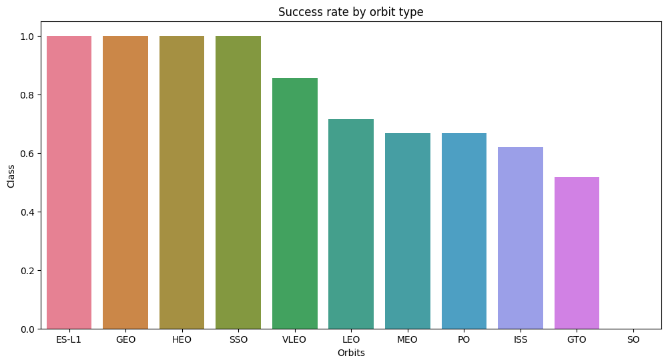
Success Rate vs. Orbit Type
This chart presents the success rates of space launches based on the target orbit.
Orbits like ES-L1, GEO, HEO, and SSO exhibit the highest success rates, indicating reliable launch capabilities. Conversely, GTO and SO orbits demonstrate lower success rates, suggesting more challenging launch conditions. The significant variation in success rates across different orbits highlights the influence of factors such as mission complexity and launch vehicle technology.

Slide 27
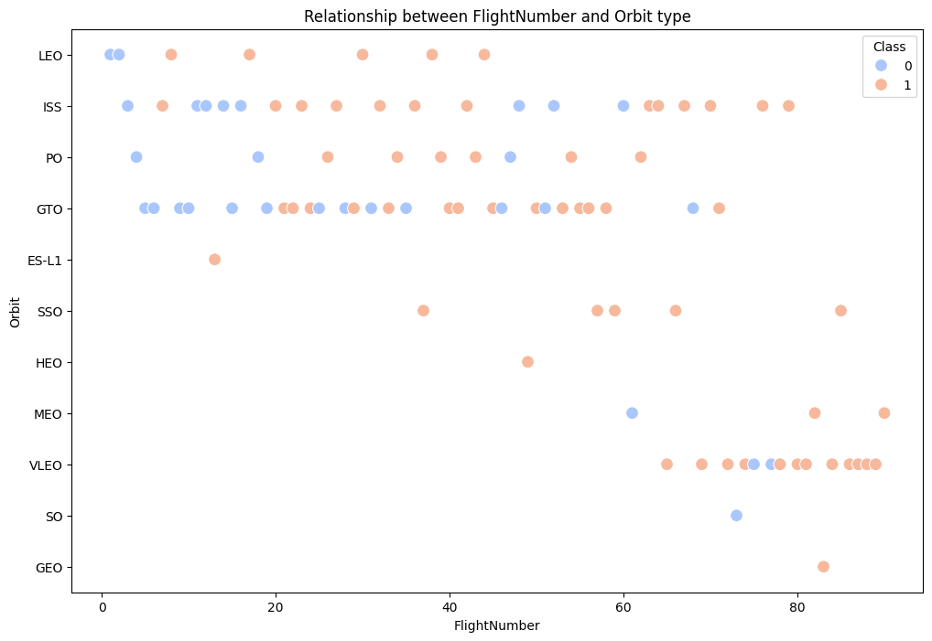
Flight Number vs. Orbit Type
Key Findings:
No clear linear relationship between flight number and orbit type.
A variety of orbit types are represented in the data.
Potential clustering of certain orbit types.
The "Class" variable (likely indicating mission success or failure) may influence the relationship between flight number and orbit type.
Possible Interpretations:
Orbit selection may not be strictly sequential or dependent on flight number.
Other factors, such as mission objectives, payload, and launch vehicle, likely influence orbit choice.
The "Class" variable could reveal patterns in mission success rates for different orbit types.

Slide 28
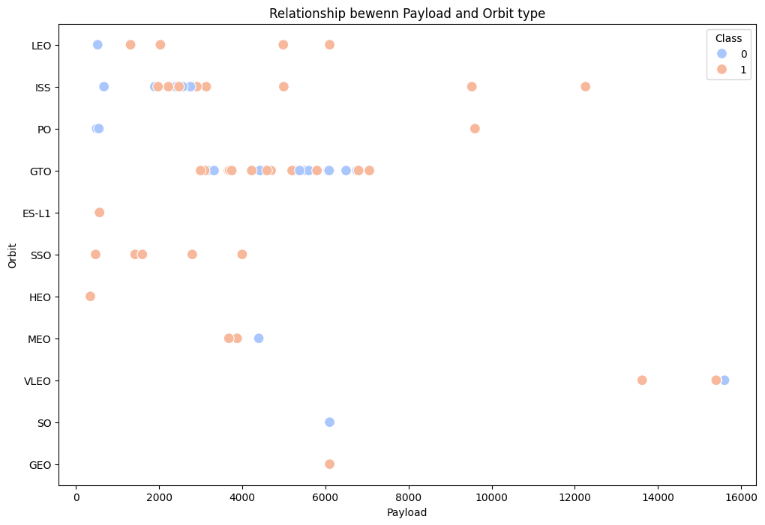
Payload vs. Orbit Type
This scatter plot illustrates the relationship between payload mass and orbit type. Each data point represents a launch, with color indicating mission success. While there's no direct linear correlation, some patterns emerge. Certain orbit types appear to be associated with specific payload mass ranges. The success or failure of a mission may also be influenced by the combination of payload mass and orbit type.

Slide 29
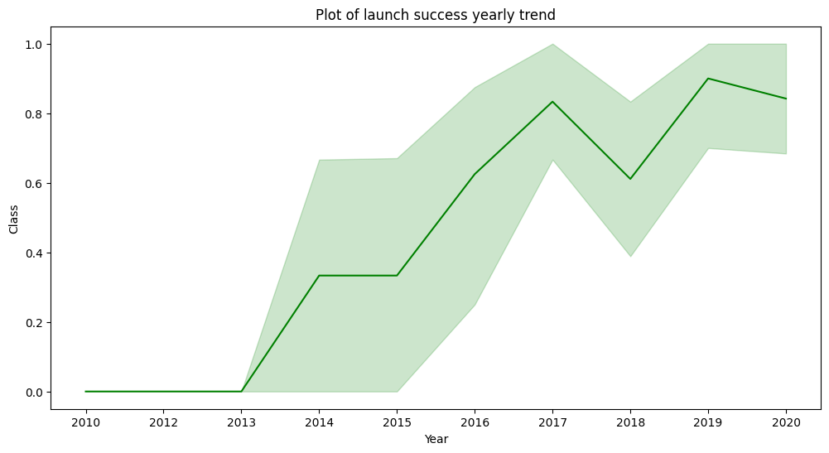
Launch Success Yearly Trend
This line graph illustrates the annual trend of launch success rates from 2010 to 2020. The green line represents the average success rate for each year, while the shaded area indicates a confidence interval.
Key Findings:
Steady increase: There is a general upward trend in launch success rates, indicating improvements in launch systems and space technologies.
Annual variability: Despite the upward trend, there are significant year-to-year variations, suggesting the influence of other factors.
Period of rapid growth: The period between 2013 and 2017 witnessed the most pronounced increase in success rates, highlighting significant advancements in launch systems.

Slide 30
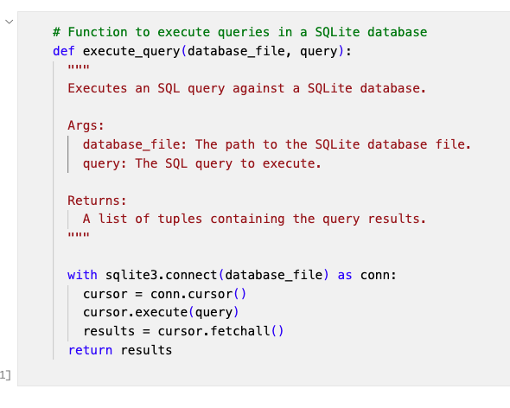
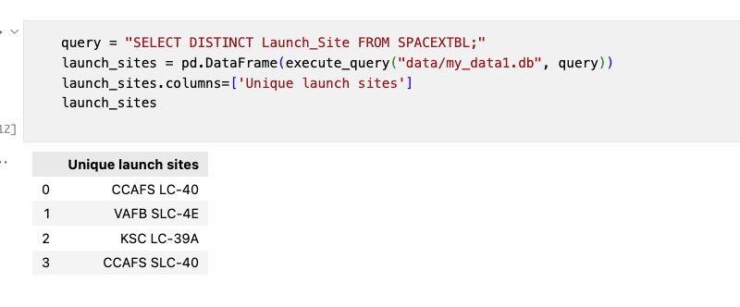
All Launch Site Names
A function was first created to execute various queries in the database, making it easier to explore different aspects of the data.
The keyword DISTINCT was used to display only unique launch sites from the SpaceX dataset.

Slide 31
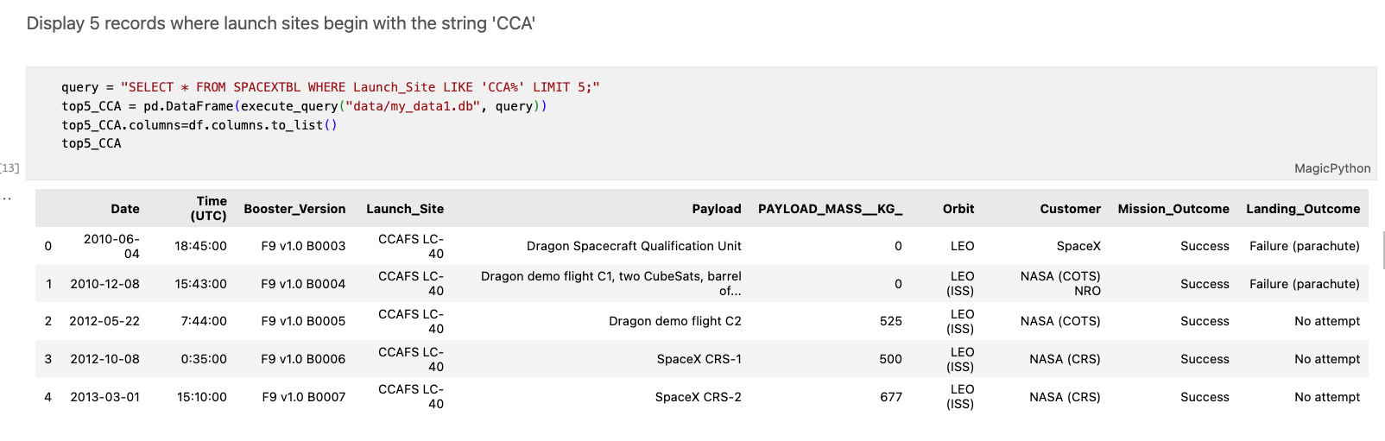
Launch Site Names Begin with 'CCA'
Find 5 records where launch sites begin with `CCA

Slide 32
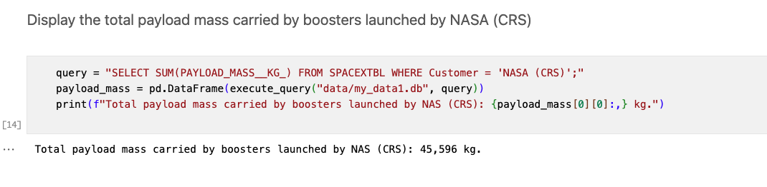
Total Payload Mass
Calculate the total payload carried by boosters from NASA

Slide 33
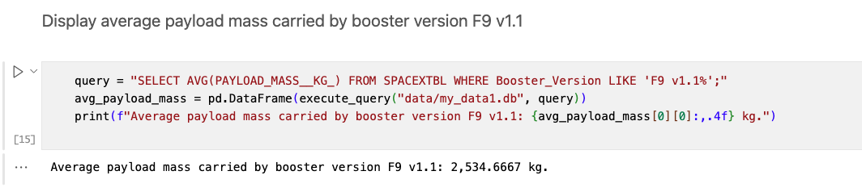
Average Payload Mass by F9 v1.1
Calculate the average payload mass carried by booster version F9 v1.1

Slide 34
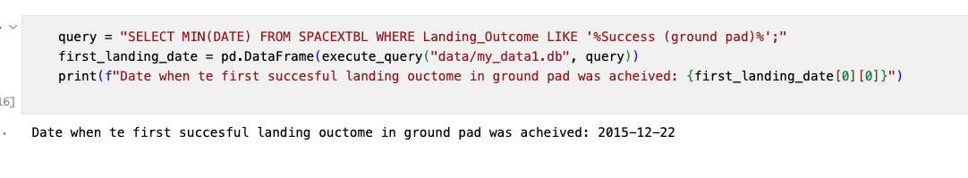
First Successful Ground Landing Date
Find the date of the first successful landing outcome on ground pad

Slide 35
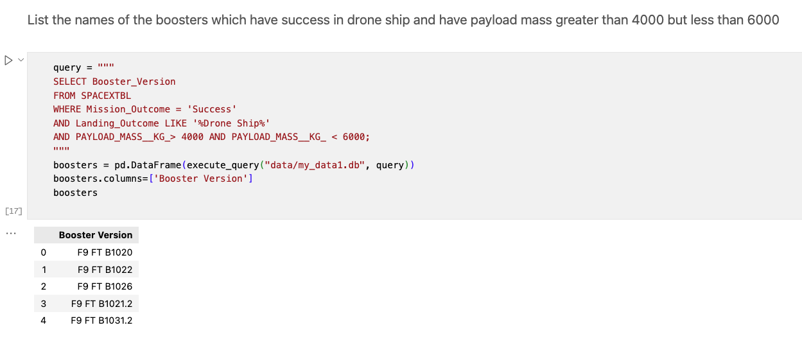
Successful Drone Ship Landing with Payload between 4000 and 6000
List the names of boosters which have successfully landed on drone ship and had payload mass greater than 4000 but less than 6000

Slide 36
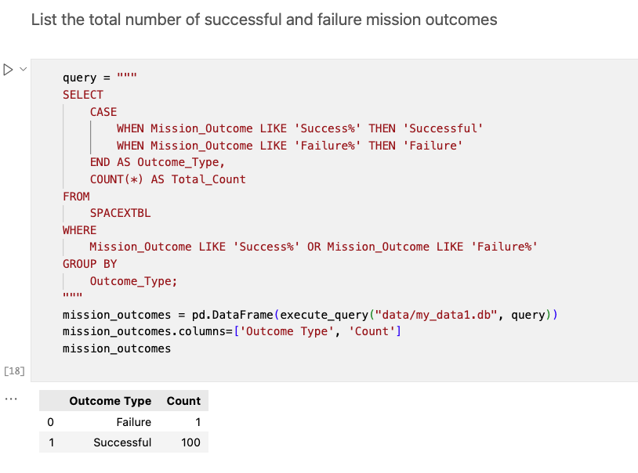
Total Number of Successful and Failure Mission Outcomes
Calculate the total number of successful and failure mission outcomes

Slide 37
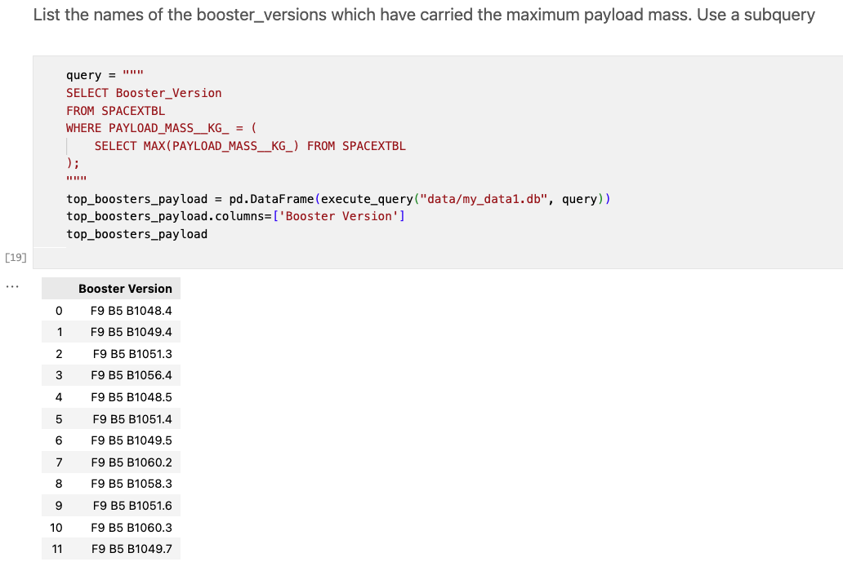
Boosters Carried Maximum Payload
List the names of the booster which have carried the maximum payload mass

Slide 38
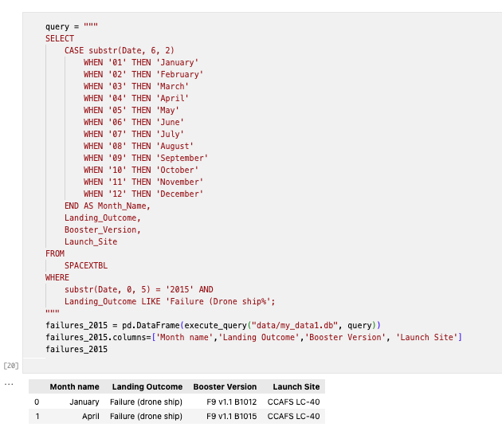
2015 Launch Records
List the failed landing_outcomes in drone ship, their booster versions, and launch site names for in year 2015

Slide 39
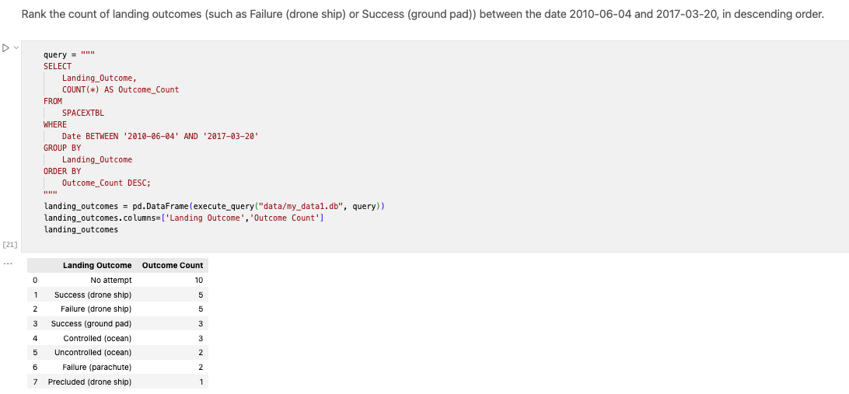
Rank Landing Outcomes Between 2010-06-04 and 2017-03-20
Rank the count of landing outcomes (such as Failure (drone ship) or Success (ground pad)) between the date 2010-06-04 and 2017-03-20, in descending order

Slide 40

Section 3

Slide 41
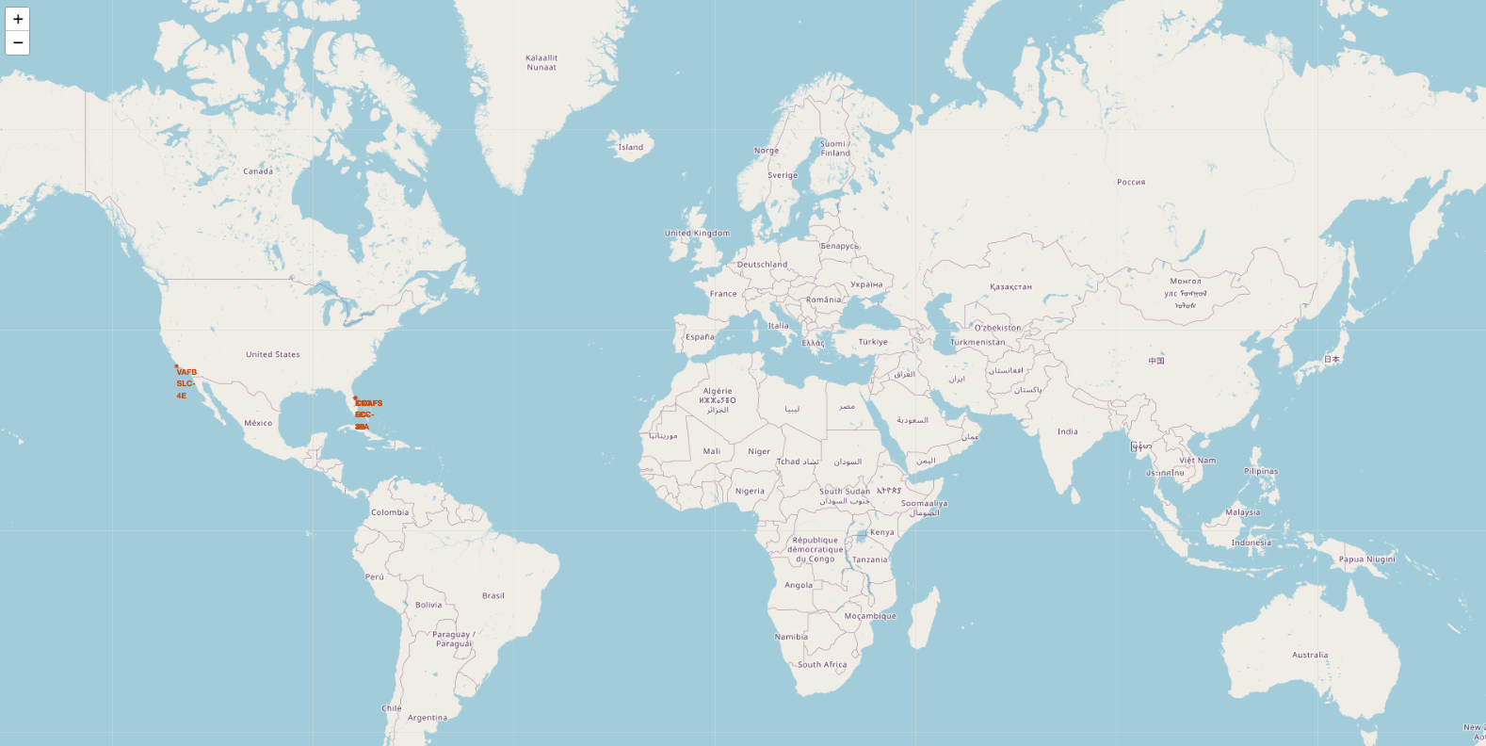
All launch sites’ location markers
All global SpaceX launch sites’ location are in the USA

Slide 42
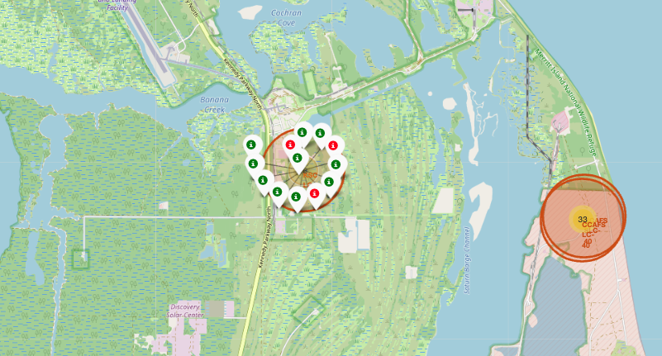
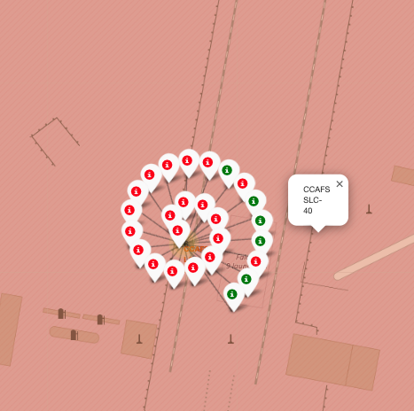
Launch sites color markers
The red markers show failures, and the green markers show success launches

Slide 43
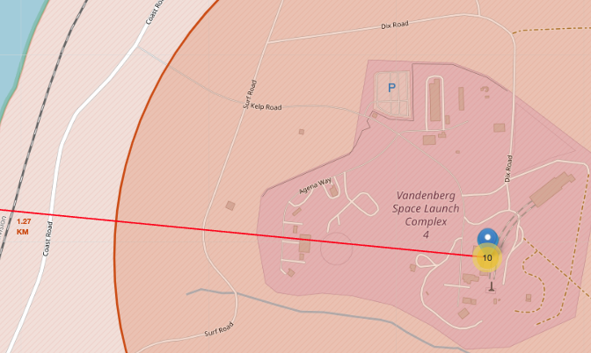
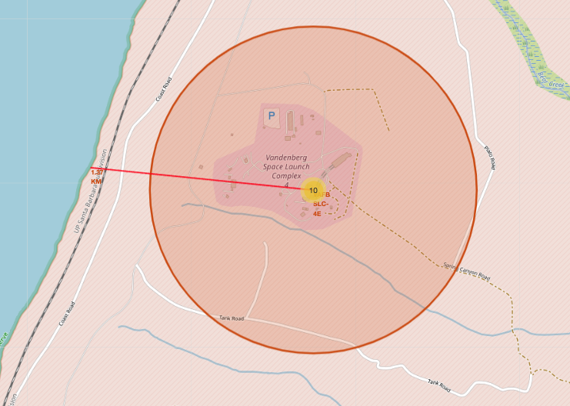
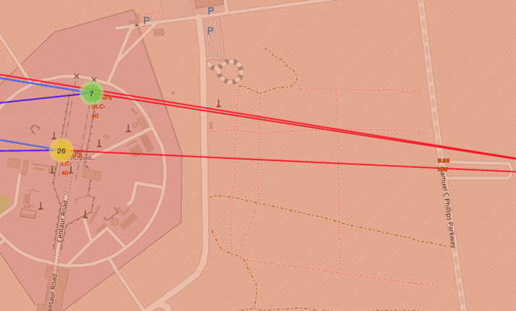
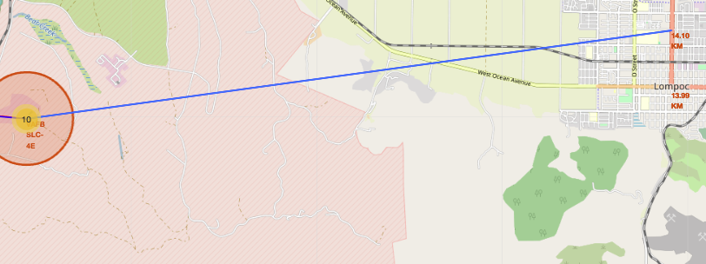
Distance from sites to landmarks
Distance to railway
Distance highway
Distance to coastline
Distance to city

Slide 44

Section 4

Slide 45
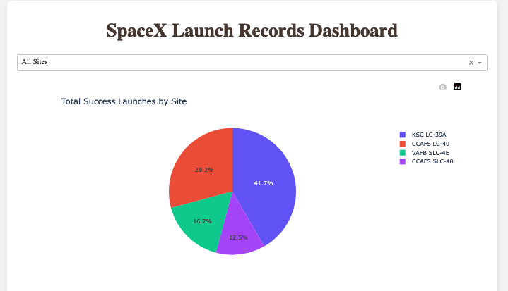
Launch success count for all sites
This pie chart provides a clear overview of the distribution of successful SpaceX launches across its various launch sites.
CCAFS LC-40: This site has seen the highest number of successful launches, accounting for 41.7% of all successful missions.
KSC LC-39A: This site follows closely behind, contributing 29.2% of successful launches.
VAFB SLC-4E: This site has seen a significantly lower number of successful launches compared to the top two, accounting for 16.7%.
CCAFS SLC-40: This site has the lowest percentage of successful launches among the four, contributing 12.5%.

Slide 46
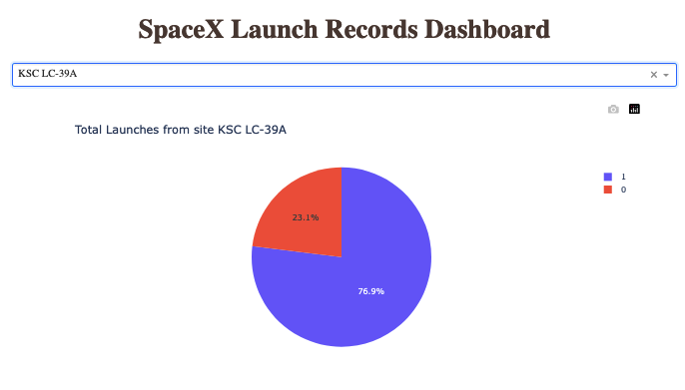
Highest launch success ratio
This pie chart provides a breakdown of launch outcomes at SpaceX's KSC LC-39A launch site.
It shows that:
76.9% of launches from this site have been successful.
23.1% of launches from this site have resulted in failures.

Slide 47
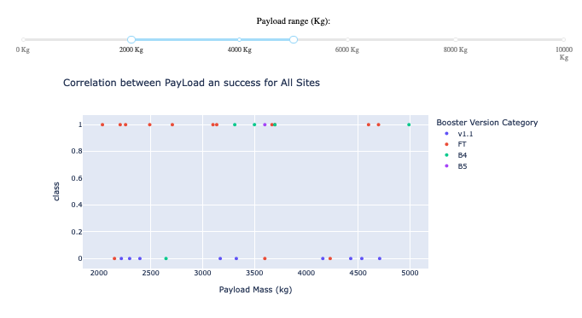
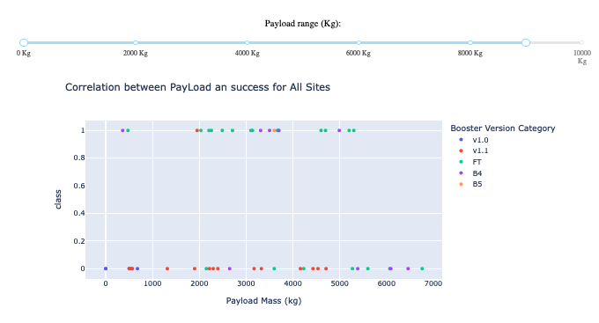
Payload vs. Launch Outcome
Both graphs seem to be exploring the relationship between payload mass and launch success for different rocket versions in SpaceX launches.

Slide 48

Section 5

Slide 49
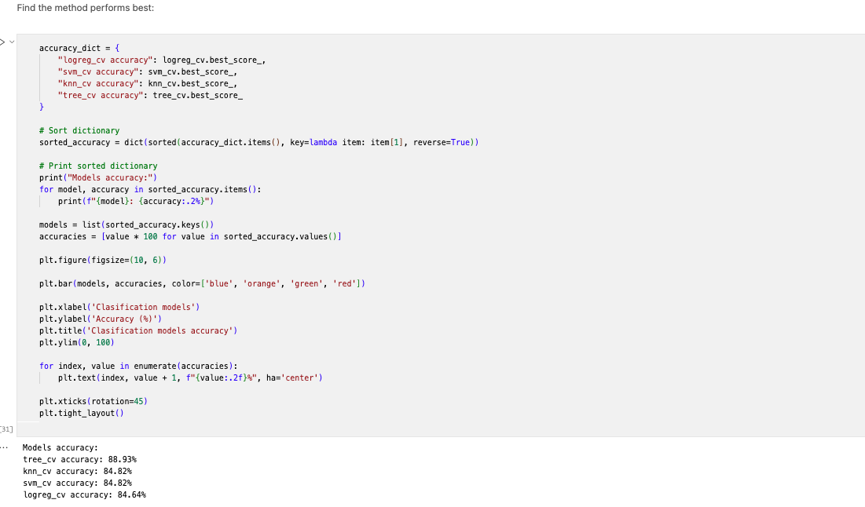
Classification Accuracy

Slide 50
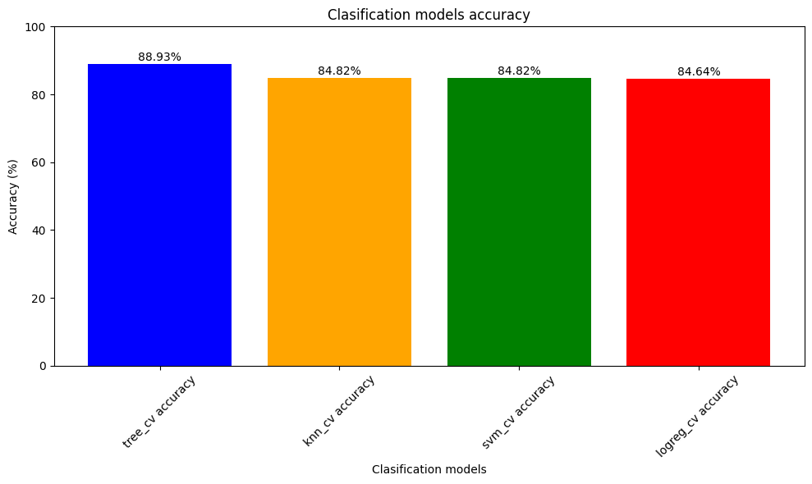
Classification Accuracy
Tree_cv model has the highest classification accuracy

Slide 51
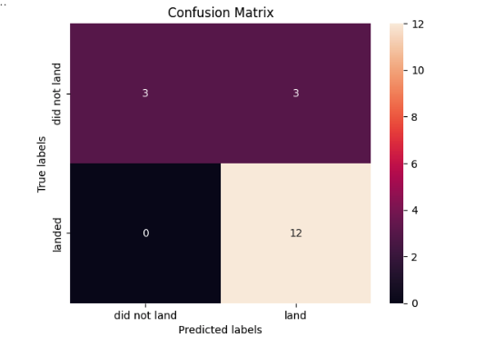
Confusion Matrix
The confusion matrix for the decision tree classifier indicates reasonable class separation. However, a significant issue arises from false positives, where the model mistakenly predicts unsuccessful landings as successful.

Slide 52
Conclusions
The analysis indicates a positive correlation between flight amount and launch success rate.
A notable upward trend in launch success rates has been observed since 2013.
Orbits ES-L1, GEO, HEO, SSO, and VLEO have consistently exhibited the highest success rates.
KSC LC-39A has emerged as the most successful launch site.
The decision tree classifier has proven to be the most suitable machine learning algorithm for this specific task.

Slide 53


